Slide 1
ENA at LaGuardia (2019): Accelerated Learning (ALP)
J. Elizabeth Clark
ENA 101 Coordinator
2019 Presentation Team:
Allia Abdullah-Matta, J. Elizabeth Clark, Tara Coleman,
Rochell Isaac, Jacqueline Jones, Phyllis Van Slyck
& Dominique Zino

Slide 2
(Brief) History of ENA at LaGuardia
2010: Peter Adams, national founder of ALP and CCBC faculty member visits LaGuardia to present on accelerated learning;
2010-2011: ENA 101 researched & developed by Heidi Johnsen;
2011-2012: ENA 101 piloted at LaGuardia
2011-2012: First round of curriculum development & course materials developed by Heidi Johnsen and a cohort of faculty (see legacy ENA 101 portfolio)
2014-2017: Informal Professional Development workshops, targeted course coordination
June 2017: CATW removed from accelerated learning CUNY-wide
2018-2019: Working Group established to revise course & develop materials
January 2018: Presentation to the Department
February 2018: Curriculum Revision for ENA (without the CATW)
2018-2019: Professional Development Seminar, Round 1
2019: Development of ENX 101
2019-2020: Professional Development, Round 2

Slide 3
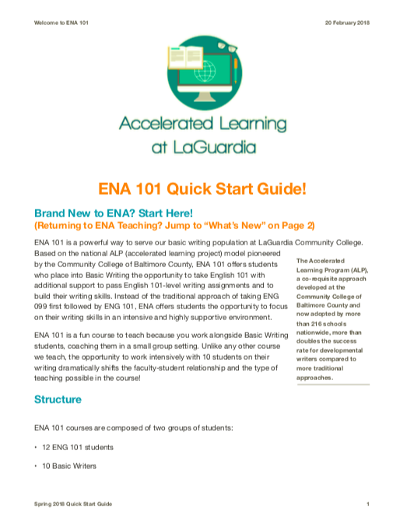
ENA 101 Course Coordination
Pre-semester organizational email with “Quick Start” guides;
ENA 101 coordinator available to review syllabi and help with course preparation;
Optional professional development workshops offered monthly during the semester;
Email communication during the semester highlighting course management issues and professional development opportunities;
Assessment data collected from IR;
Participated in CUNY Task Force on Multiple Measures;
Materials for ENA 101, created as part of paid professional development workshops, available on the department’s Composition Program ePortfolio.

Slide 4
ENA 101 is Now the Default Basic Writing Course at LaGuardia
Course | Fall 2011 | Spring 2012 | Fall 2012 | Spring 2013 | Fall 2013 | Spring 2014 | Fall 2014 | Spring 2015
ENG 099 | 27 | 34 | 28 | 23 | 22 | 14 | 13 | 14
ENA 101 | 4 | 8 | 13 | 18 | 21 | 24 | 26 | 27
Course | Fall 2015 | Spring 2016 | Fall 2016 | Spring 2017 | Fall 2017 | Spring 2018 | Fall 2018 | Spring 2019
ENG 099 | 13 | 9 | 11 | 9 | 10 | 8 | 8 | 5
ENA 101 | 29 | 27 | 29 | 25 | 29 | 25 | 31 | 26

Slide 5
LaGuardia’s structure: pure ALP model (CCBC)
ALP students are mainstreamed into “regular” Comp I courses with Comp I students
10 ALP students + 12 non-ALP Composition I students
Students enroll into the same section using different codes: ENG 101 for regular composition, ENA 101 for ALP
4 hours of instructional classroom time together
M | Tu | W | Th | F
10:30-12:45 Composition I 22 students |  | 10:30-12:45 Composition I 22 students

Slide 6
LaGuardia’s structure: pure ALP model (CCBC)
Three hours per week of additional instructional time for 10 ALP students
Taught by same prof as Comp I course
Total of 7 contact hours for professor
M | Tu | W | Th | F
10:30-12:45 Composition I 22 students | 10:30-12:45 ALP course 10 students | 10:30-12:45 Composition I 22 students | 10:30-11:30 ALP course 10 students

Slide 7
Revised (2019) Course Description
In this course students write coherent essays in varied academic formats, both in and out of class, responding to culturally diverse materials and using appropriate technology. Students focus on critical and analytical skills through reading and listening. They also study aspects of argumentation, including formulating theses; researching and identifying sources; evaluating and documenting sources; and communicating persuasively across contexts, purposes, and media. Three additional hours each week support students with lower placement scores in achieving college-level writing with an emphasis on the recursive writing process and intensive practice in college-level writing. Admission is based on college placement test scores. Course meets seven classroom hours weekly.

Slide 8
Current ALP Placement at LaGuardia (2019)
**Proposed Placement Changes CUNY-Wide will affect this**
Passed ACCUPLACER Reading (reading score of 55+)
Received a failing score on the CUNY Assessment Test in Writing (CATW) placement exam between 36-55.
OR...
Placed into CSE 099 (reading score of 45‐54) as a co-requisite for the course
Received a failing score on the CUNY Assessment Test in Writing (CATW) placement exam between 36-55.
OR...
Received an "R" in ENG 099 and were advised into ENA 101 for additional basic writing practice.
Note: In some select cases, ESL students at the highest level of ESL have been advised into ENA 101 by ESL faculty. We do not differentiate between new and continuing ALP students.

Slide 9
New ENA 101 Course Objectives (2019)
Objectives 1-7 match the new ENG 101 exactly. ENA 101 adds the following 3 objectives:
8. Provide students with individualized support and practice throughout all
phases of the writing process to ensure the development of college-level writing skills to be successful in English 101.
9. Reinforce the reading and writing opportunities provided in English 101.
10. Provide students with additional time to develop a deeper understanding of
the recursive writing process necessary for college composition.

Slide 10
Supporting Changes

Slide 11
ENA 101 at LaGuardia, Post-CATW (2017): Building Something New
Invited Susan Gabriel from Community College of Baltimore County’s ALP Program to re-establish best practices in acceleration;
Established a working group in Fall 2017 / Winter 2018 to research best practices and to make recommendations about structural changes in the course;
Created 2 year-long professional development seminars for ENA 101 faculty (2018-2019, 2019-2020);
Situated our work in the context of: the national conversation about acceleration, our composition program’s responses to our most recent Periodic Program Review (including a new curriculum map), and our institutional assessment practices.

Slide 12
ENA 101 at LaGuardia, Post-CATW:
Cultural Shifts (2017-2018)
Researched literature: reviewed best practices in ALP pedagogy; reviewed best practices in Basic Writing pedagogy; reviewed best practices in Writing Centers;
Researched practices from other campuses: ALP syllabi, Comp I syllabi; Writing Center offerings & practices;
Situated our ALP course at LaGuardia: reviewed LaGuardia’s ENG 101 course goals; reviewed LaGuardia’s ENG 102 course goals;
Recommended structured curriculum changes: aligned ENA 101 to support ENG 101 course goals;
Developed & documented: new and existing practices in our own courses as models for the newest iteration of the course;
Created research questions for considering how to evaluate ENA 101;
Rewrote the course with new targeted objectives;
Created a best practices document;
Please see Working Group January 2018 presentation.

Slide 13
Faculty / Departmental Goals for ENA 101 at LaGuardia
Building capacity for grounded composition practices in the department;
Building deep knowledge about acceleration;
Building investment in the structure, pedagogy, and practices of the course;
Providing training for faculty to engage with the revised course outcomes, structure, and pedagogy;
Linking pedagogy & assessment;
Laying groundwork for assessment practices in ENA 101.

Slide 14
2018-2019 Year-Long Professional Development Seminar
Supported by the Strong Start to Finish Grant;
Continues the work of the 2017-2018 Working Group;
Organized around the key principles in the new ENA 101 framework;
Faculty met monthly to read key articles, create activities, and develop fluency with the ENA 101 principles.

Slide 15
Pedagogical Support & New ENA Framework

Slide 17
LaGuardia’s Framework
In the Classroom:
Deceleration
Integrating reading & writing
Habits of mind
Improving thinking skills
Responding to affective issues
Introducing academic discourse
Improving self-editing
Working towards a multilingual paradigm
For Faculty:
Backwards design
Shared lesson plans
Professional development

Slide 22
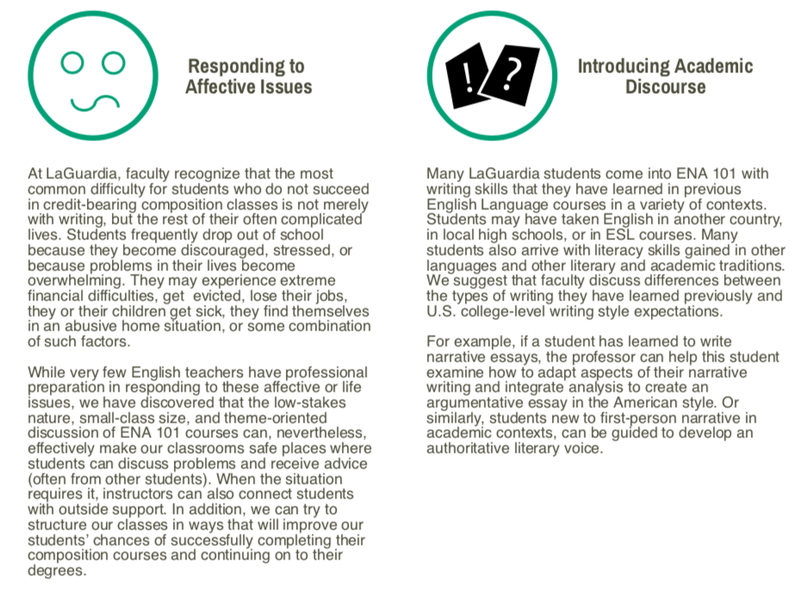

Slide 25
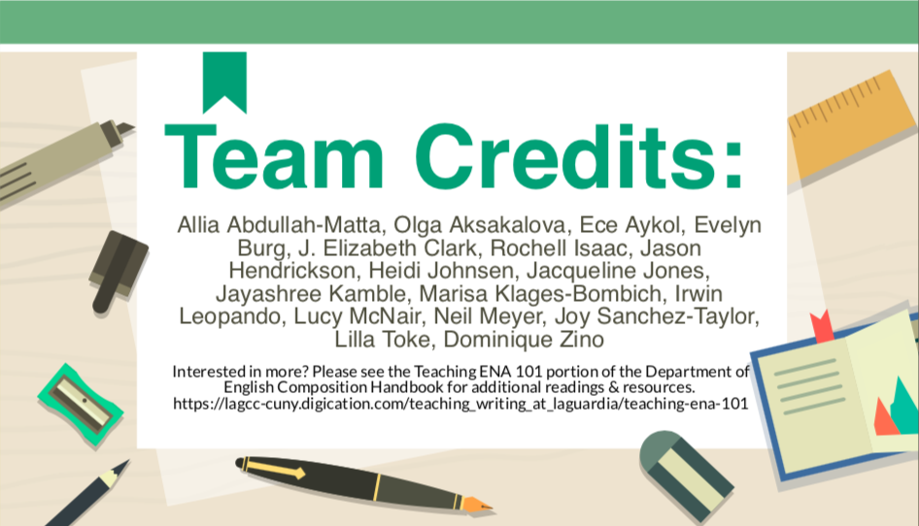

Slide 26
Tara Coleman & Phyllis Van Slyck: Using the ENA Framework to Design Classroom Materials

Slide 27
Tara: Introducing Academic Discourse & Supporting Multilingual Students
dictionary of academic and composition keywords;
activities to identify the difference between formal/informal discourse, audience, and also transferring knowledge from one domain for the other;
supporting students with identifying concepts or strategies they already know in other terms or languages.

Slide 28
Tara’s Audio Memo #1
In an audio recording of 2-3 minutes, describe your use of language in everyday life:
· What do you think is distinctive about the way you talk?
· How do you talk or present yourself differently when you are with different groups of people?
· Do you speak multiple languages? Do you use different versions of the same language in different situations, or mix languages with certain people?
· If you had to identify a particular word, phrase or style of speech that is your “signature” – what would it be? What does it show us about you? (For example, my grandfather always says, “To make a long story short…” after he has already been telling a very long story! It shows that he loves giving detailed explanations, but forgets about his audience at times.)
You can use one of the voice memo apps that come with most smartphones, or use an online recorder like this one: https://online-voice-recorder.com/ When you are done, you can upload/save the file to your Google drive folder. This is a very casual assignment, so feel free to share whatever comes to mind. No pressure!

Slide 29
Tara’s Journal Entry #1
For this entry, I would like you to compare the way you use language in your everyday life and in your academic life. If your first audio memo, which you recorded, you talked about the languages you speak, how you use language in your daily life, and so on. Now I would like you to discuss how you think the language or languages you use in school are similar to or different from the way you use language outside of school. What kinds of opportunities or anxieties arise in this context that may not arise when using language in daily life? What kind of “voice” did you think you used in the audio memo you recorded and how does it compare to the “voice” you have, or would like to have, as a writer? Be as specific as you can, and give examples when possible.

Slide 30
Phyllis’ Backwards Design: Group Flyer Design
Targeted outcome for ENA/G 101: #2: become familiar with “. . . audience, voice, context, purpose” and #4 early assignments that allow students to practice using summation, paraphrase, citation. . .”
Group classroom activity: after reading the essay “Mississippi Appendectomy,” in the book Medical Apartheid by Harriet A. Washington, design a flyer (on whiteboard) to be given out at your local hospital or community center warning citizens, especially women, about the dangerous forced sterilization practices. Use information from the reading to strengthen your argument. Each group will present their flyer to the class.

Slide 31
References in article to ways women of color were targeted and misled (removal of appendix or gallbladder) when they were actually sterilized

Slide 32
Group Flyer Warning Community of Sterilization

Slide 33
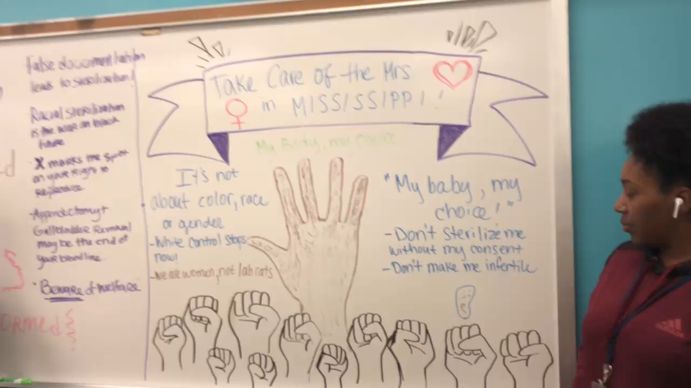
References in article to sterilization without consent and racial targeting

Slide 34
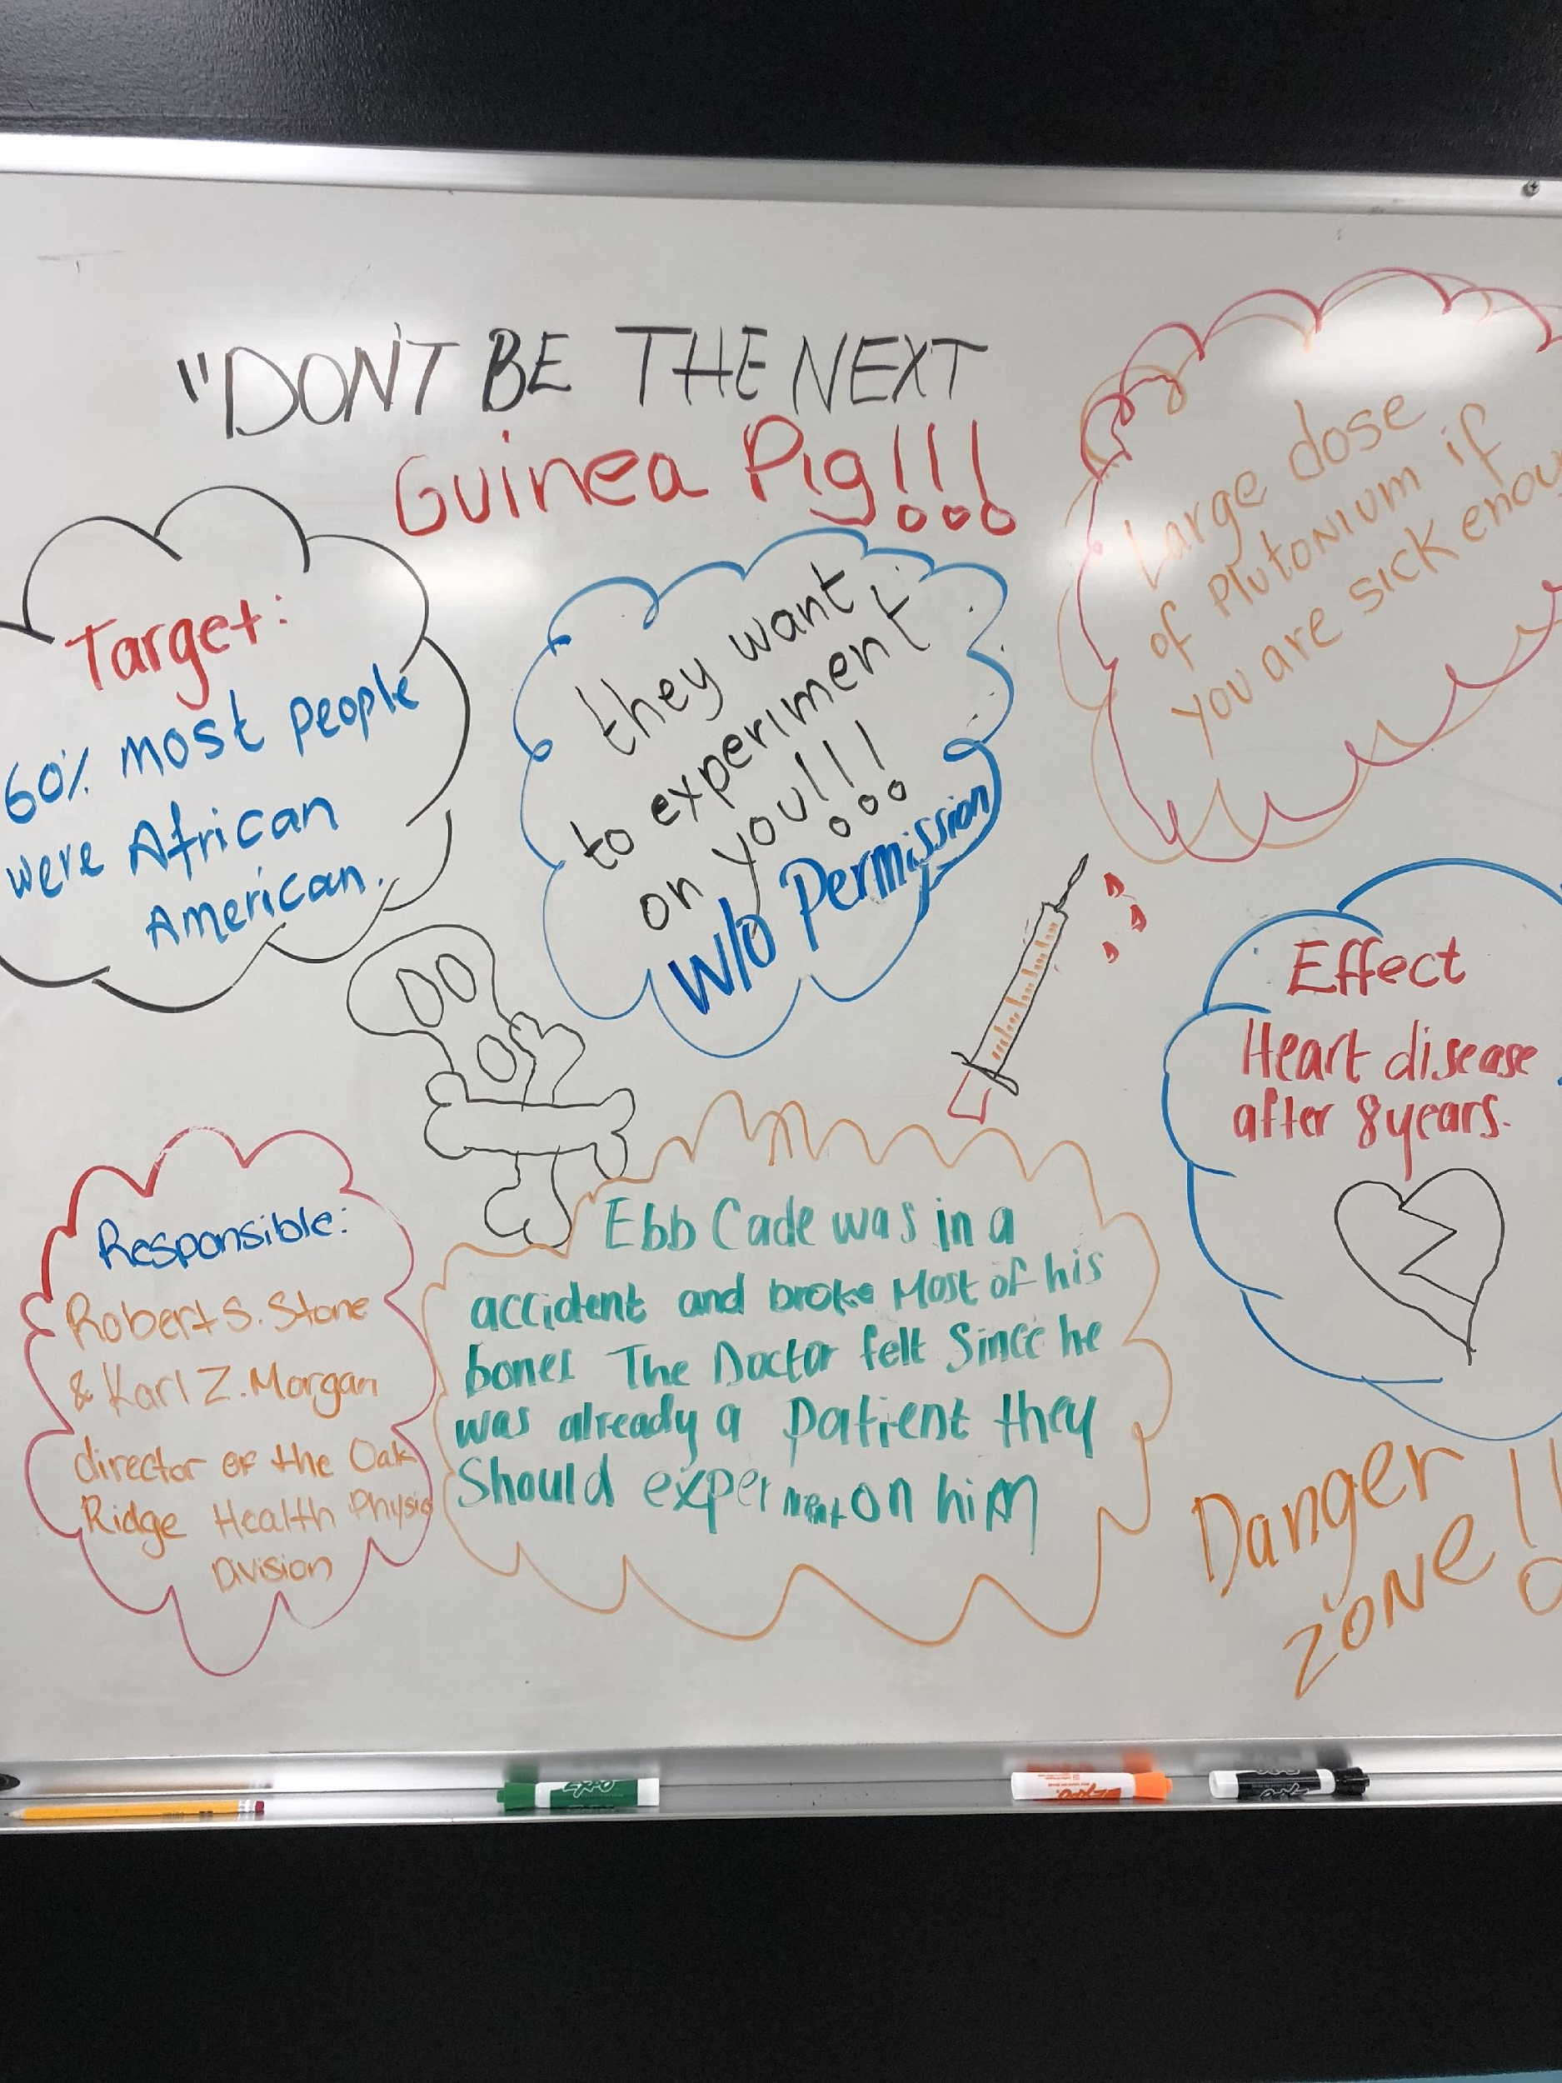
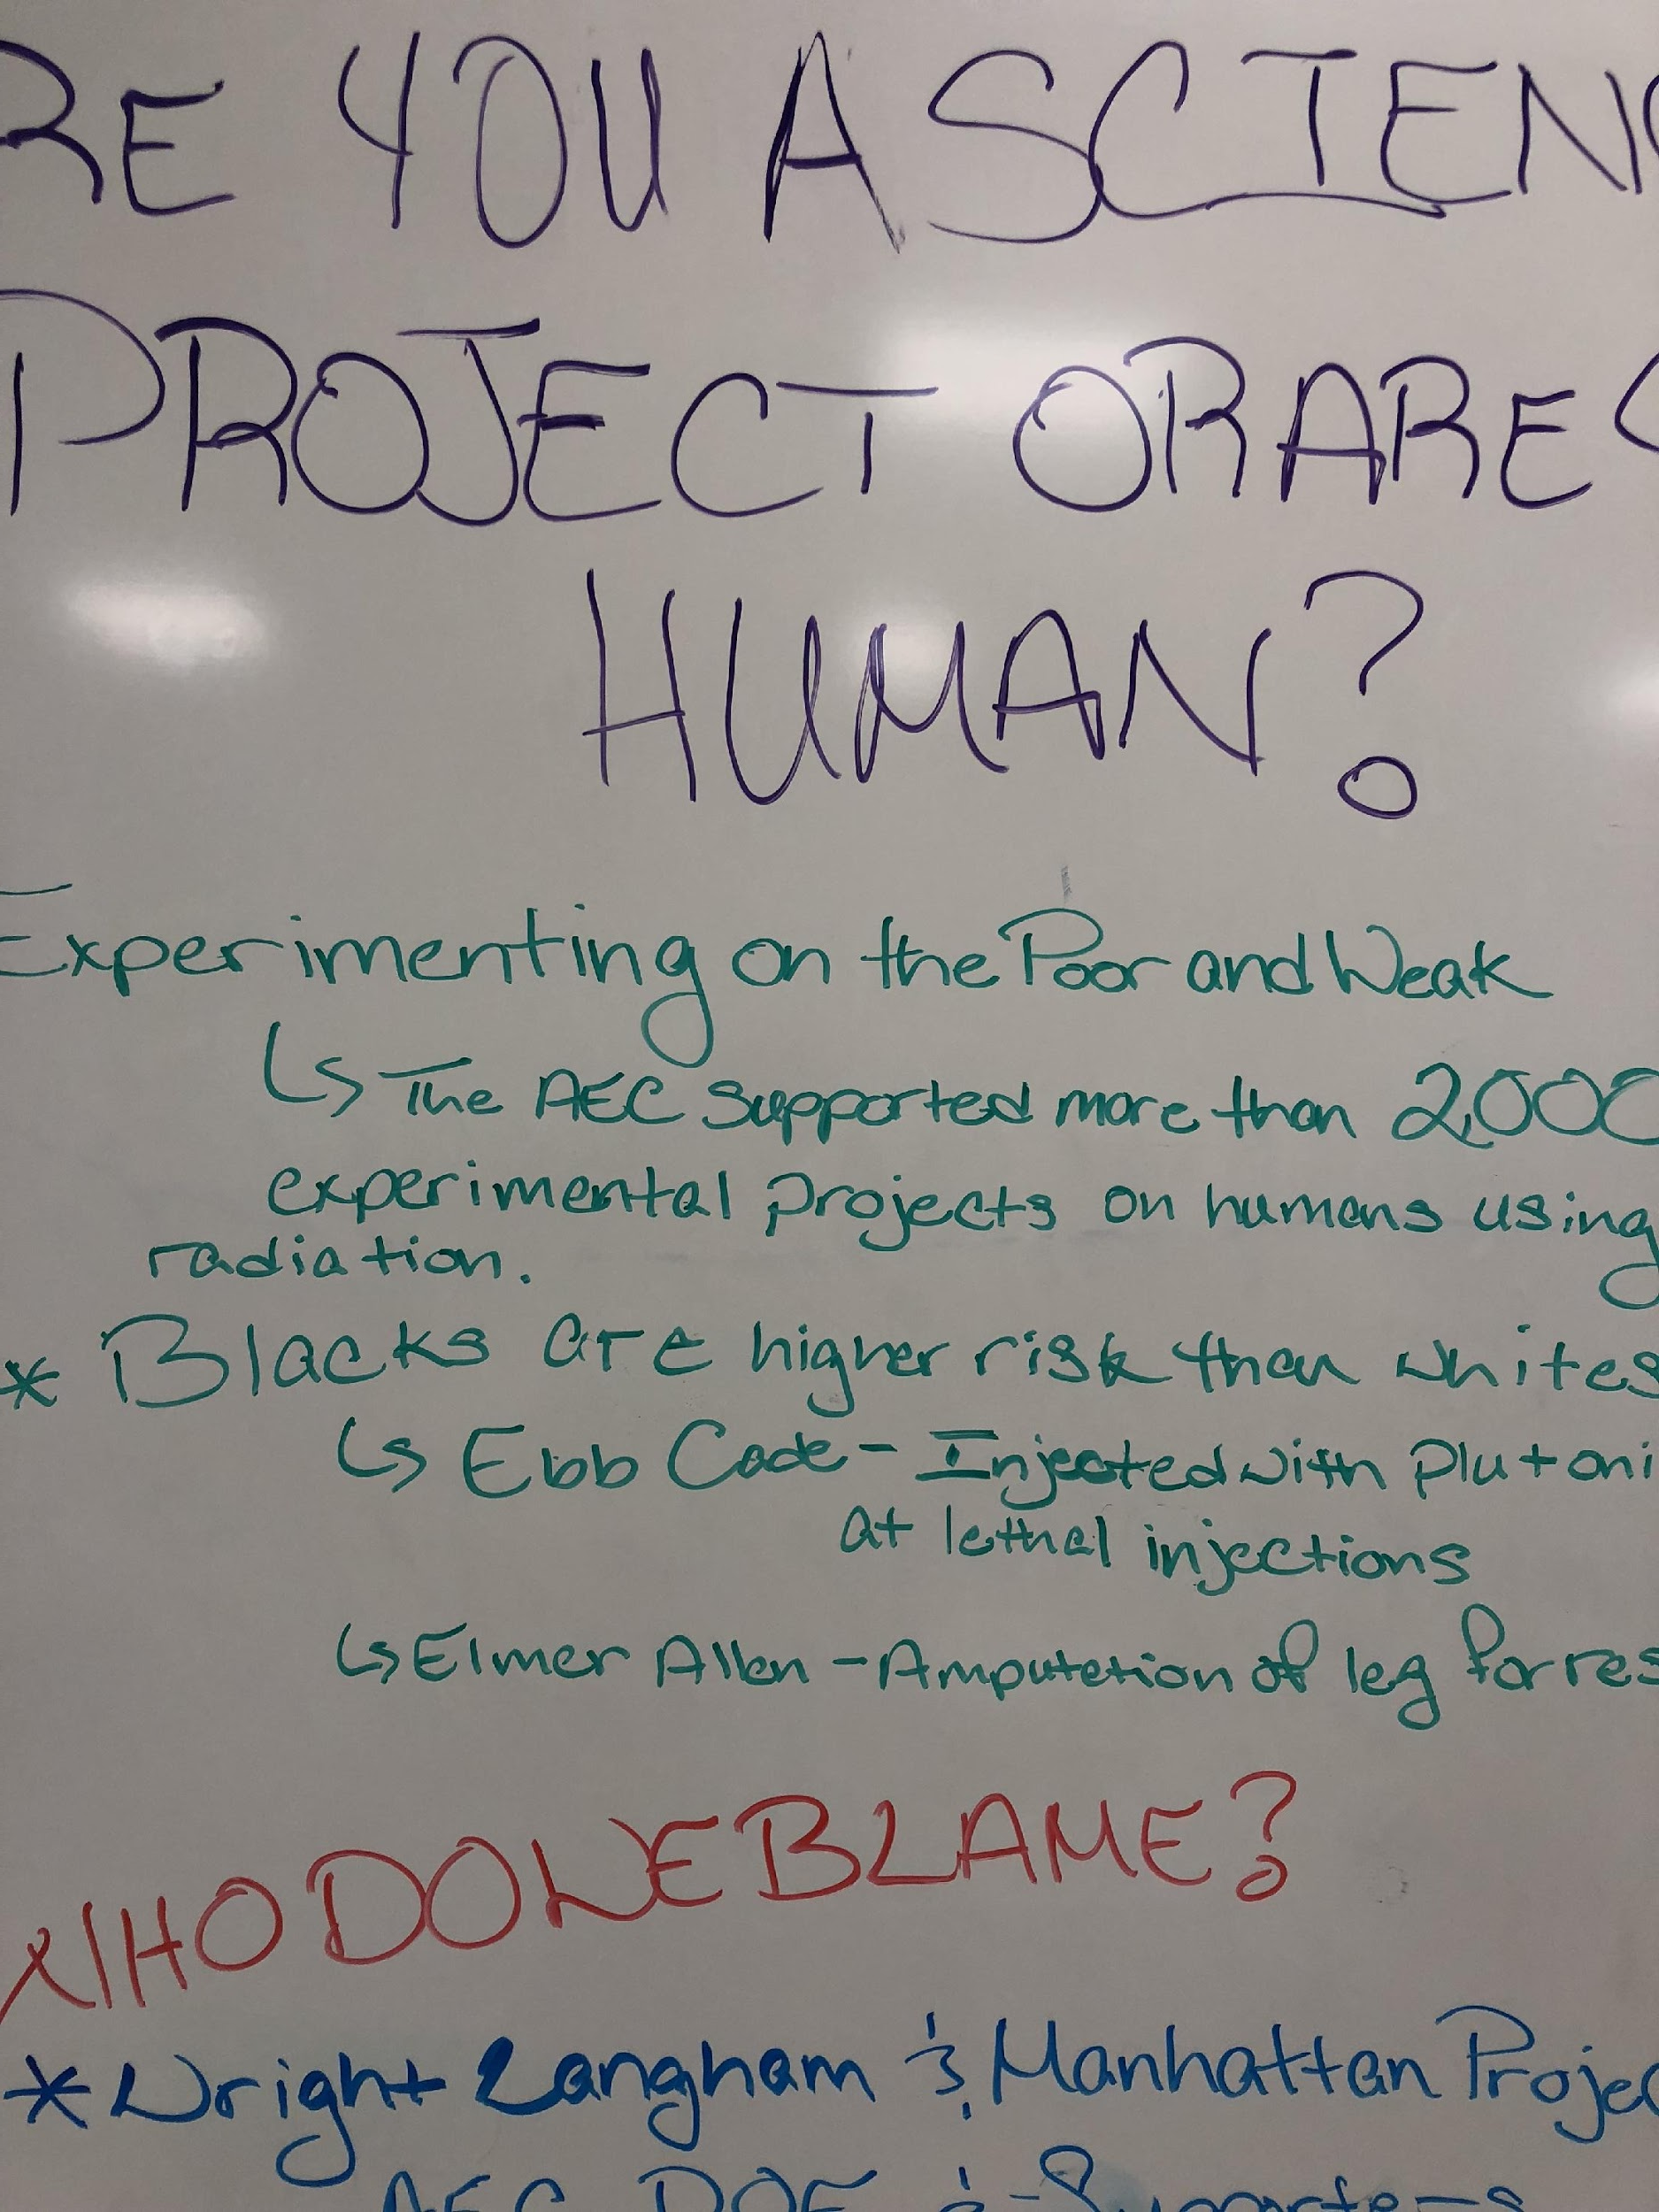
References to specific cases where moribund patients were experimented upon.
ENG 101 Theme:
Is this Eugenics?

Slide 35
Targeted outcome for ENG 101: #6—enable students to design later assignments that enable them to develop research skills . . .
You have viewed and discussed the documentary, War on the Weak and Tomorrow’s Children, and you have read the essay “Forgotten Lessons of the American Eugenics Movement.”
You are now invited to write a letter to the editor of the Indiana Times in which you forcefully describe your concerns about the growing eugenics movement. The time in which you are writing is roughly 1930, after the Supreme Court decision re Buck vs Bell. (“Three generations of imbeciles is enough,” argued Oliver Wendell Holmes in 1927.) You may be a journalist, a concerned citizen, a doctor or a scientist. You should use the three sources we have studied in your letter, and document them in MLA 8 format. Your letter should be approximately two typewritten double-spaced pages.

Slide 36
Sample essay excerpt

Slide 37
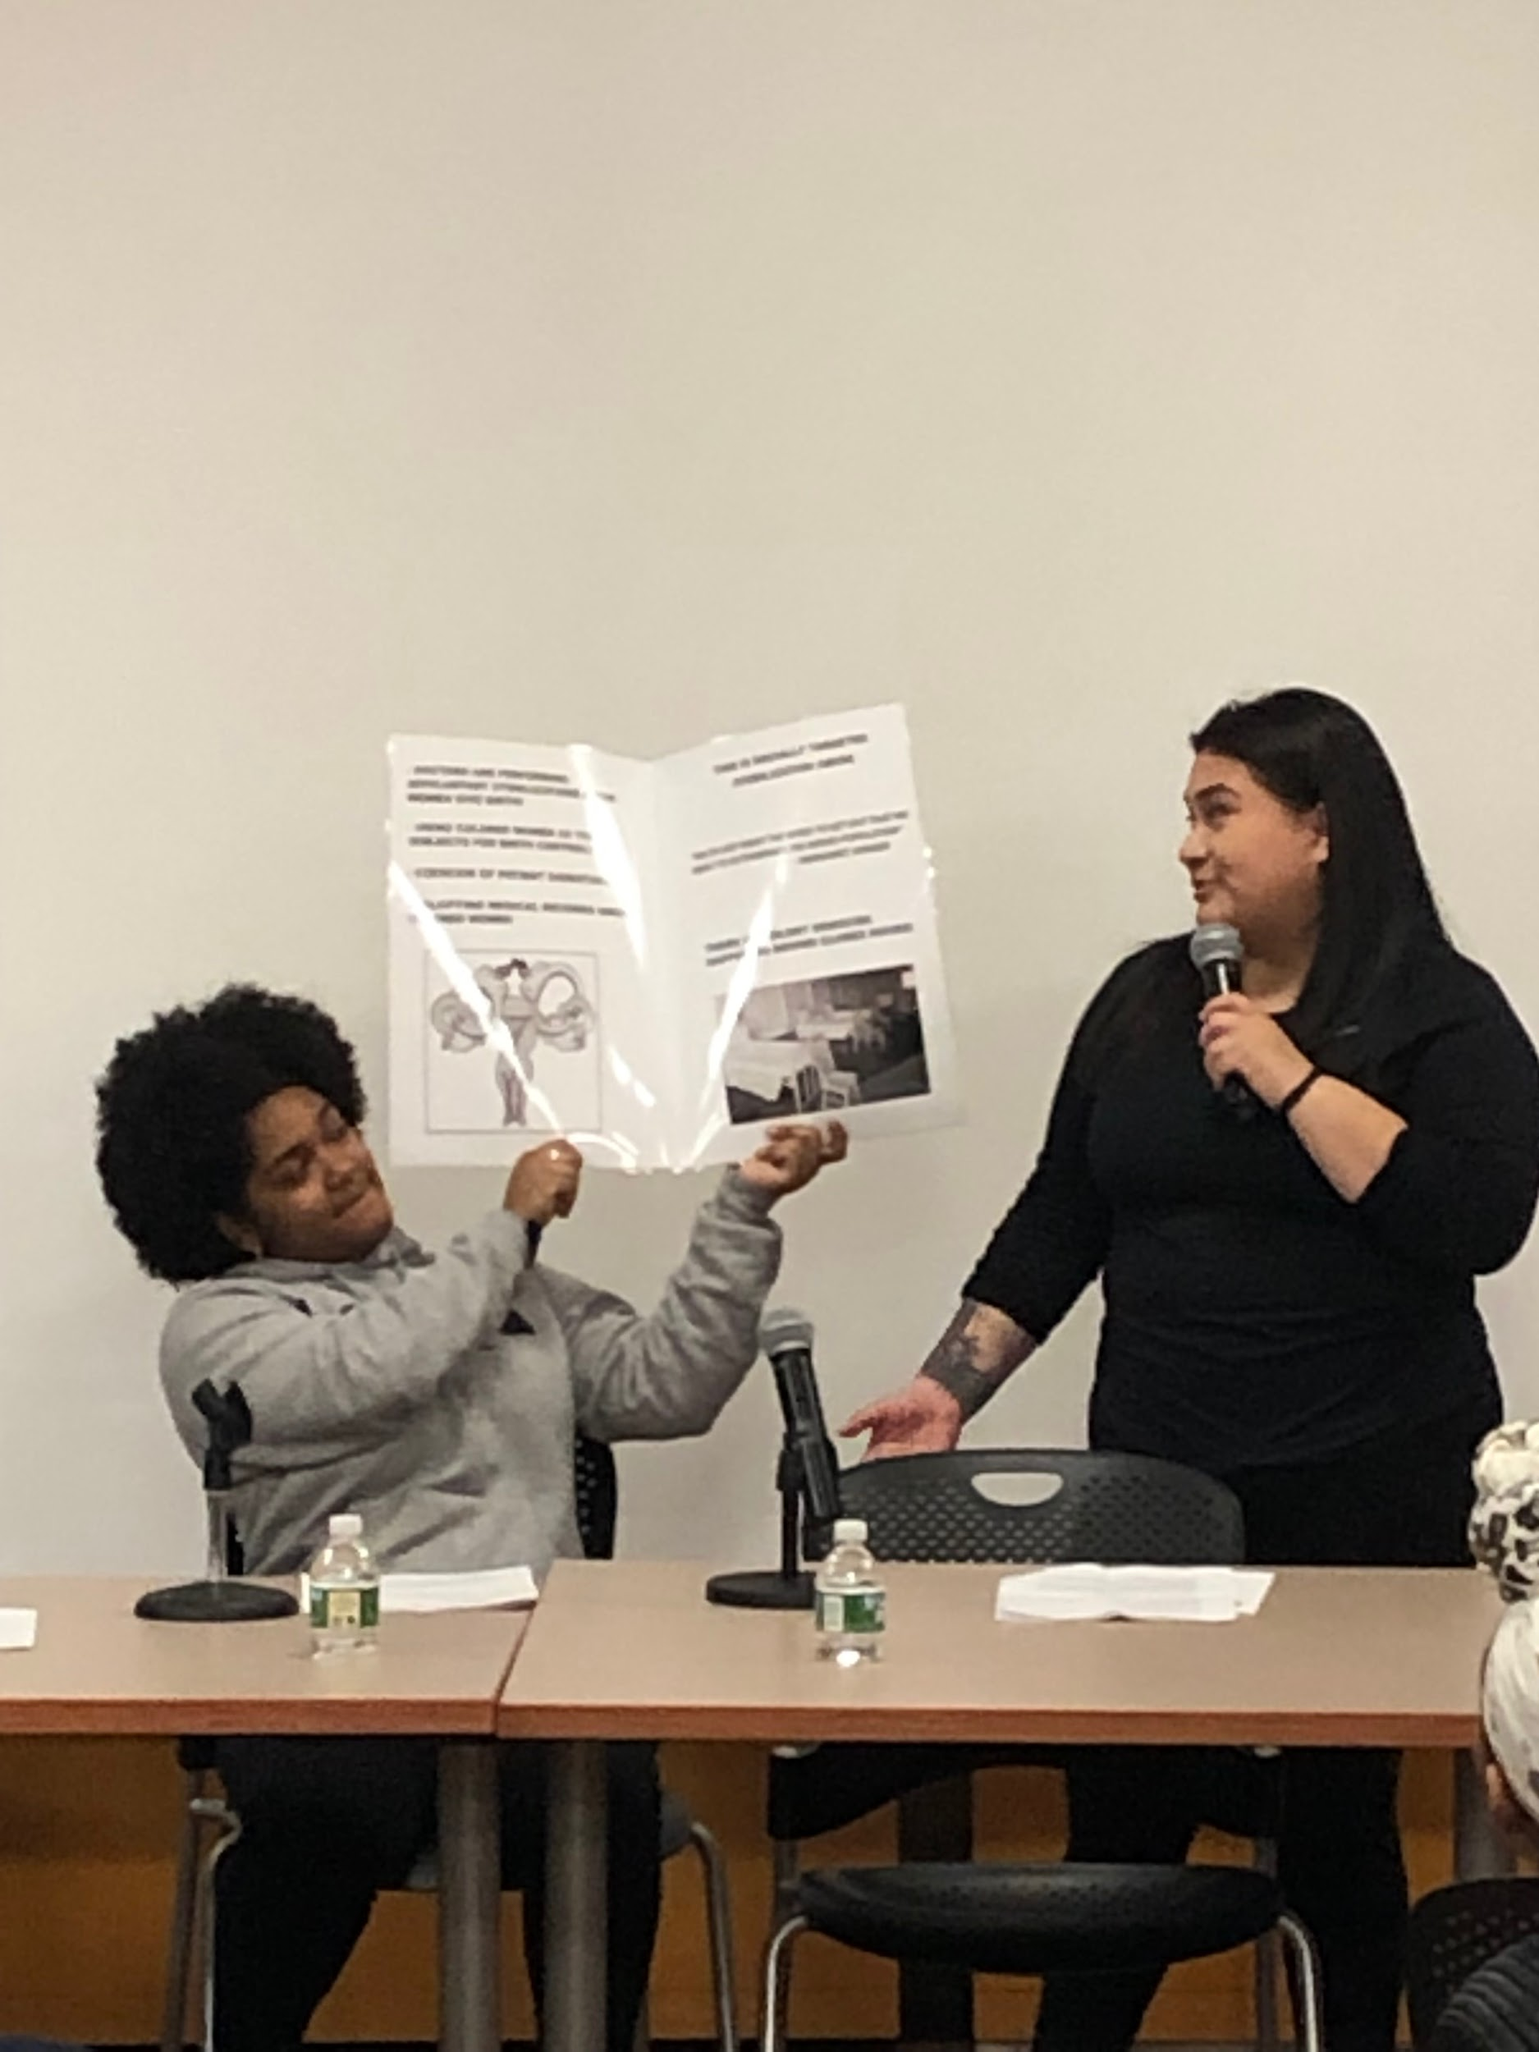

Slide 38
2018-2019 Assessment

Slide 39
LaGuardia’s Research Questions & Sample Data from Working Group
Pass Rates for ENG 099, ENG 101, ENA 101
ENA 101 Grade Distribution
Reading Placement Score Comparisons for ENG 099 and ENA 101
ENG 102 pass rates based on ENG 099 vs. ENA 101 vs. ENG 101 placement
Pass Rates for ENA 101 students who failed their reading placement exam
ESL vs. Non-ESL ENA 101 pass rates

Slide 40
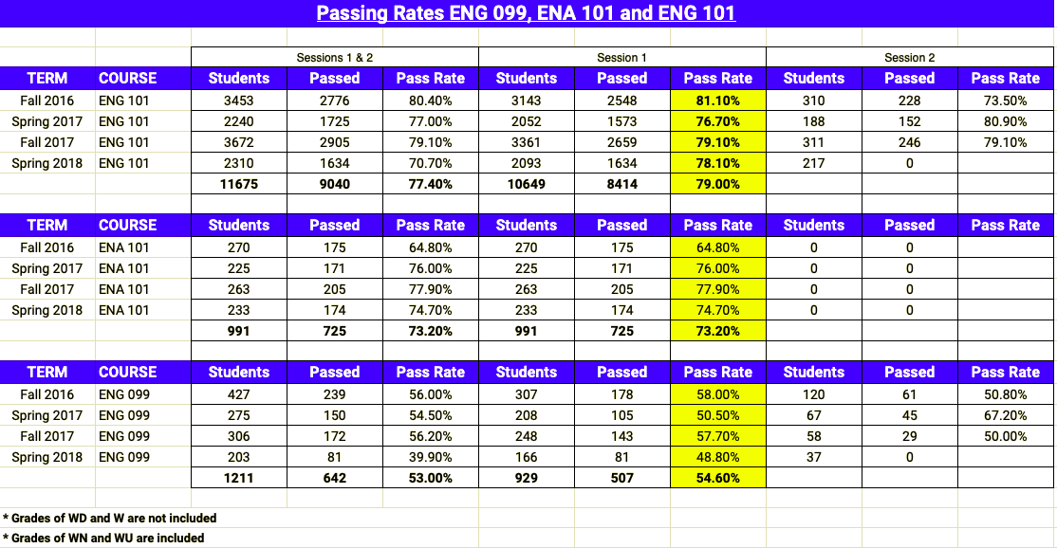
LaGuardia: Comparative Pass Rates

Slide 41
LaGuardia: ENA 101 Grade Distribution

Slide 42
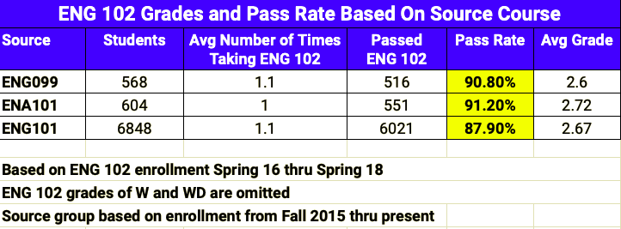
LaGuardia: ENG 102 Pass Rates Based on Original Placement

Slide 43
LaGuardia: ESL vs. Non-ESL ENA 101 Pass Rates

Slide 44
ENA 2018-2019 Assessment
Pre and post essays from 23 sections
220 pre essays
210 post essays
5 scorers: J. Elizabeth Clark, Tara Coleman, Rochell Isaac, Marisa Klages-Bombich, Sue Livingston
Each essay read twice; third reads for scorer discrepancies
Descriptive Assessment process

Slide 45
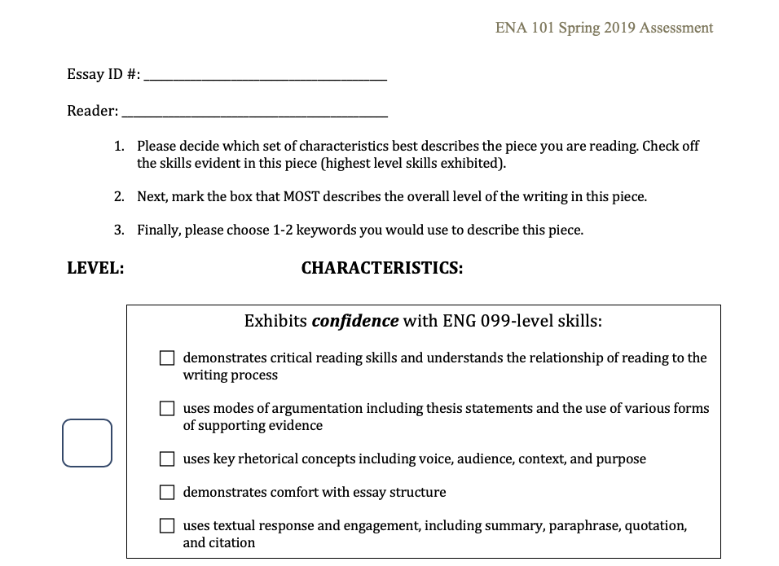

Slide 46
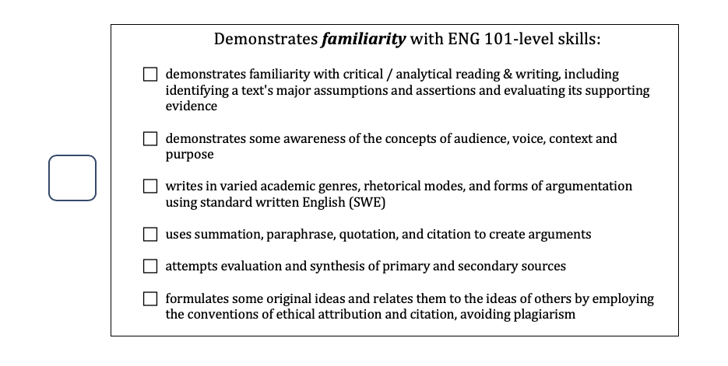

Slide 47
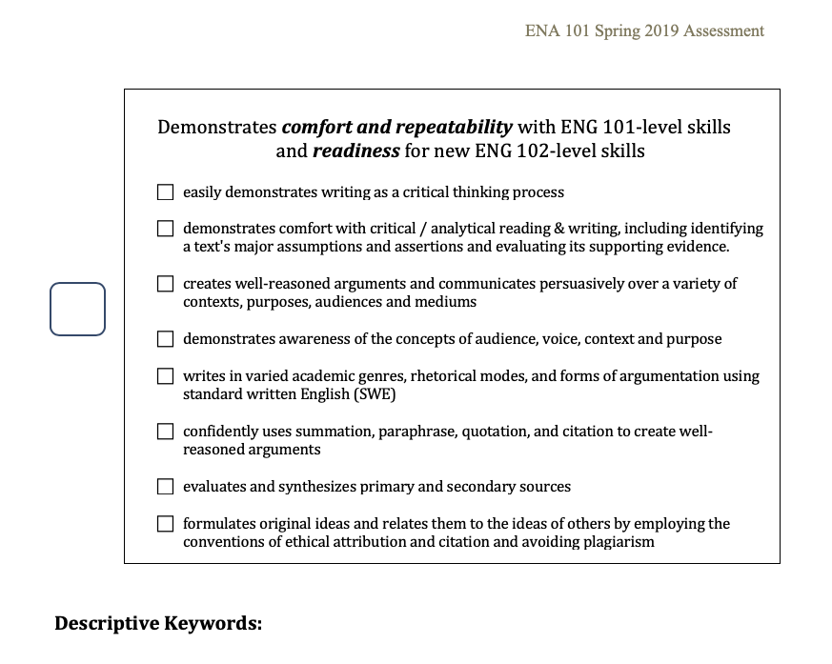

Slide 48
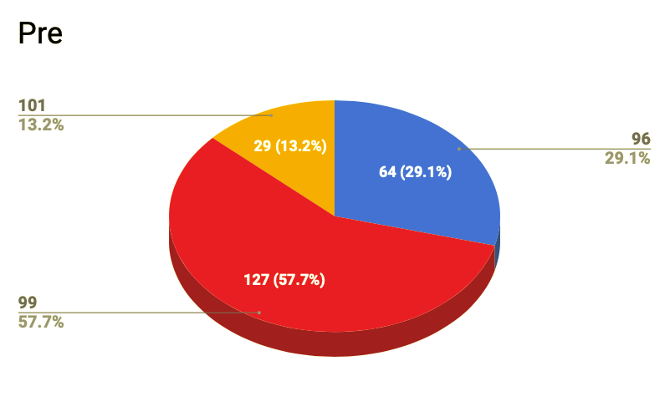
Pre
101-level
Below 099
099-level

Slide 49
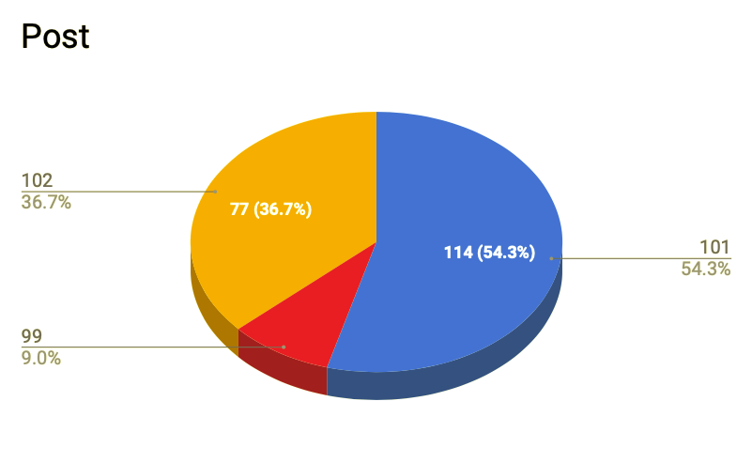
Post
102-level
101-level
19
(9%)
099-level

Slide 50
 | Pre | Post
Below 099 | 64 (29.1%) | 0
099 | 127 (57.7%) | 19 (9%)
101 | 29 (13.2%) | 114 (54.3%)
102 | 0 | 77 (36.7%)
Totals | 220 | 210
Pre and Post Comparison

Slide 51
ENG 099 (and below) Descriptions
Not an essay
Seems like answers to questions
Too short
Too short to meet 099 standards
No real thesis
Mixing ideas
No development
Not sure of thesis
Too short to categorize
Summary—no development
Mostly personal narrative
???
Self-intro, doesn’t fully meet 099 skills
Uses thesis & quote
Lacks details
Short
Has structure
ESL?

Slide 52
ENG 101 Descriptions
Integration of text
Nice combination of quotes and summary/paraphrase
Cohesive and original thinking
Identifies the points in the reading
Some evaluation
Integrates quotations, but the overall purpose is unclear
Lots of sources, integration gets weaker later on
Strong thesis, turns into mostly summary
No real textual conclusion
Ethos, logos, pathos
Not as detailed as others in set
Loses steam
Uses quotes okay
Repetitive
Reflection
Reflection--hard to assess
Stilted

Slide 53
ENG 102 Descriptions
Strong thesis and use of quotes
Does a nice analysis of own work including quotations
Good organization
Choppy language but clear argument
Good use of text
Good connection to text
Strong voice and analysis
Funny!
Sophisticated
Strong use of text
Really interesting
Well organized research!
Nice job! Well argued!
Organized
Reflection
Good analysis
Interpretation

Slide 54
Identified ENG 099 Skills in Samples
demonstrates critical reading skills and understands the relationship of reading to the writing process
uses modes of argumentation including thesis statements and the use of various forms of supporting evidence
uses key rhetorical concepts including voice, audience, context, and purpose
demonstrates comfort with essay structure
uses textual response and engagement, including summary, paraphrase, quotation, and citation
Level | Pre (127) | Post (19)
099-1 | 58 | 9
099-2 | 42 | 1
099-3 | 20 | 0
099-4 | 111 | 15
099-5 | 80 | 12

Slide 55
Identified ENG 101 Skills in Samples
demonstrates critical reading skills and understands the relationship of reading to the writing process
uses modes of argumentation including thesis statements and the use of various forms of supporting evidence
uses key rhetorical concepts including voice, audience, context, and purpose
demonstrates comfort with essay structure
uses textual response and engagement, including summary, paraphrase, quotation, and citation
Level | Pre (29) | Post (114)
101-1 | 8 | 90
101-2 | 3 | 31
101-3 | 0 | 72
101-4 | 14 | 60
101-5 | 10 | 87
101-6 | 17 | 62

Slide 56
Identified ENG 102 Skills in Samples
easily demonstrates writing as a critical thinking process
demonstrates comfort with critical / analytical reading & writing, including identifying a text's major assumptions and assertions and evaluating its supporting evidence
creates well-reasoned arguments and communicates persuasively over a variety of contexts, purposes, audiences and mediums
demonstrates awareness of the concepts of audience, voice, context and purpose
writes in varied academic genres, rhetorical modes, and forms of argumentation using standard written English (SWE)
confidently uses summation, paraphrase, quotation, and citation to create well-reasoned arguments
evaluates and synthesizes primary and secondary sources
formulates original ideas and relates them to the ideas of others by employing the conventions of ethical attribution and citation and avoiding plagiarism
Level | Pre (0) | Post (77)
102-1 | 0 | 48
102-2 | 0 | 38
102-3 | 0 | 27
102-4 | 0 | 35
102-5 | 0 | 22
102-6 | 0 | 24
102-7 | 0 | 33
102-8 | 0 | 31

Slide 57
ENX 101: Filling a need
Being developed by Belkis Gonzalez and Irwin Leopando;
New course to fill a gap for students who have taken ENA 101, have completed basic skills, but need a bit more work in preparation for ENG 102;
Curriculum is focused on backwards design (ENG 102) and ENA-101 Framework;
2 sections to be piloted in August 2019.

Slide 58
Next steps
Not done
Implementation of new curriculum in fall 2019;
Pilot ENX course in August 2019;
Academic Year 2019-2020 Professional Development Workshop;
May 2020: assessment of pre- and post-ENA 101 writing;
Continued development of curriculum materials;
Figuring out placement with CUNY-wide placement changes.
Writing center referral;
Discussion of exit criteria;
Student version of the ENA framework.

Slide 59
Many Thanks
2018-2019 Team:
Allia Abdullah-Matta
Olga Aksakalova
Ece Aykol
Evelyn Burg
J. Elizabeth Clark
Rochell Isaac
Jason Hendrickson
Heidi Johnsen
Jacqueline Jones
Jayashree Kamble
Marisa Klages-Bombich
Irwin Leopando
Lucy McNair
Neil Meyer
Joy Sanchez-Taylor
Lilla Toke
Dominique Zino
2019-2020 Team:
J. Elizabeth Clark
Tara Coleman
Belkis Gonzalez
Carlos Hiraldo
Rochell Isaac
Lara Kattekola
Marisa Klages-Bombich
Sue Livingston
Neil Meyer
Phyllis Van Slyck
Jesse Schwartz
Dominique Zino
WPA Team:
J. Elizabeth Clark
Jacqueline Jones
Neil Meyer
Lykourgos Vasileiou
ENX Team:
Belkis Gonzalez
Irwin Leopando
IR Data:
Jeffrey Weintraub
Assessment Team:
J. Elizabeth Clark
Tara Coleman
Rochell Isaac
Marisa Klages-Bombich
Sue Livingston

Slide 60
Final intention
“An admitted student is a qualified student ...students accepted into community colleges deserve the dignity of placement and curricular alignment that ensures their success.” (Poe, Nastal, and Elliot 2019)

