Slide 1
Revision and Self-Editing in ENA 101
A Guide to "Glow Up” Your Writing
Narrated by Dr. Lauren Navarro

Slide 2
Why revise?
Revision and editing can transform an average first draft into an exceptional final paper.
We learn from self-evaluation. When you take a step back to re-envision a piece of writing, it helps you to identify patterns and learn about the craft of writing.
The more you revise, the better you become at writing. When you revise, you preview your work on behalf of your future reader. By doing so, you will get better at writing for a variety of audiences.
To get a better grade. 😋

Slide 3
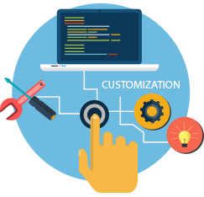
Customize your self-editing approach
Revision is a process that it takes some time to get comfortable with. The best way to do this is trial and error. By trying out different strategies, you can find out what works best for you. Here are some tips:
Use a user-friendly editing tool
Remember to give your work time to “rest”
Aim for proficient, not perfect
Know when to hit send!¹
*Portions of this were modified from “Customize Your Self-Editing Approach” by Sage Cohen—Writer’s Digest

Slide 4
Seven steps to a foolproof revision
Complete your draft. Then Revise.
Kill your darlings.
Read your work aloud.
Revisit your sentences.
Reexamine your conclusion.
Check for errors.
Enlist a second reader (or more)!²
*Portions of this presentation were modified from “7 Steps to a Foolproof Revision” by Don Fry—Writer’s Digest

Slide 5
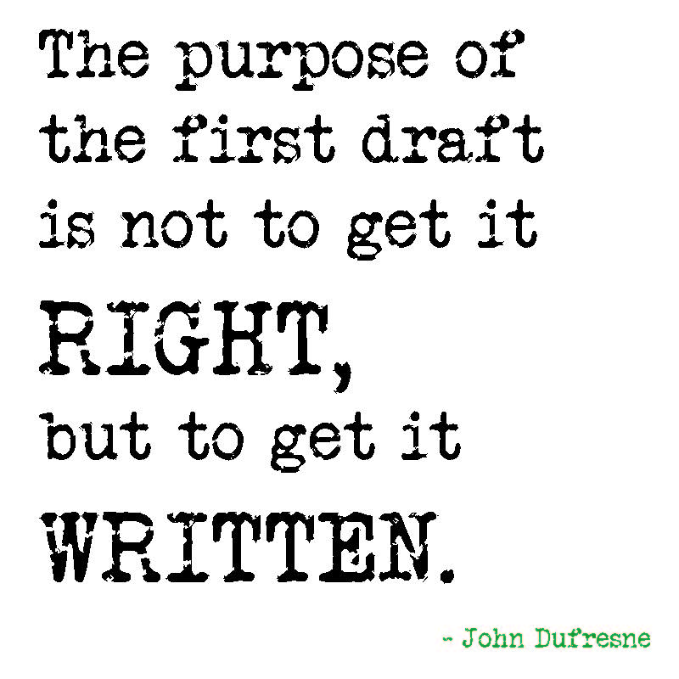
Step one: Complete your draft, Then revise
You can revise various pieces of your draft as you go along (especially if your professor asks you to write in stages). However, always remember to revisit your completed draft!
Often, you will finish more quickly if you draft the entire piece first. Revisiting the same sentence or paragraph repeatedly can slow down your progress.
Looking at the completed draft enables you to see how each part fits together.
When you revise, go from big to small—first, look at the big picture, then at each paragraph, and last, at sentence-level issues.

Slide 6
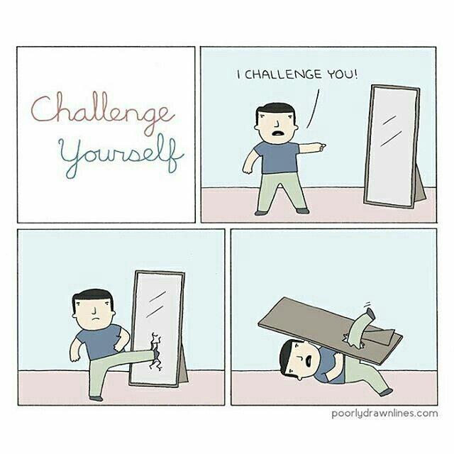
Step two: Kill your darlings
One of the most challenging things for a writer to do is to edit their own work.
Often, when you’ve worked hard on something you think every word needs to stay in there.
It helps to leave it alone for a bit and come back to it!
If a sentence or a paragraph looks too long, it probably is! Find a way to cut it down.

Slide 7
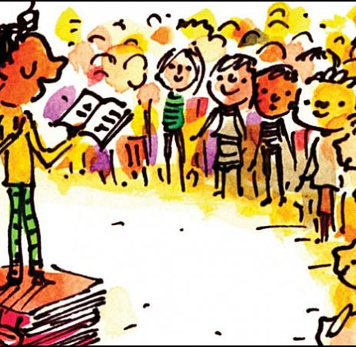
Step three: read your work aloud
Reading your draft aloud can immediately clue you in to what needs work.
Read it loud and proud! Make sure to mark anything that bothers you as you read along. Don’t change it yet, just mark it.
Running out of breath, misspelled words, lapses in grammar, sentences that don’t make sense, and missing words are all clues you need a correction!

Slide 8
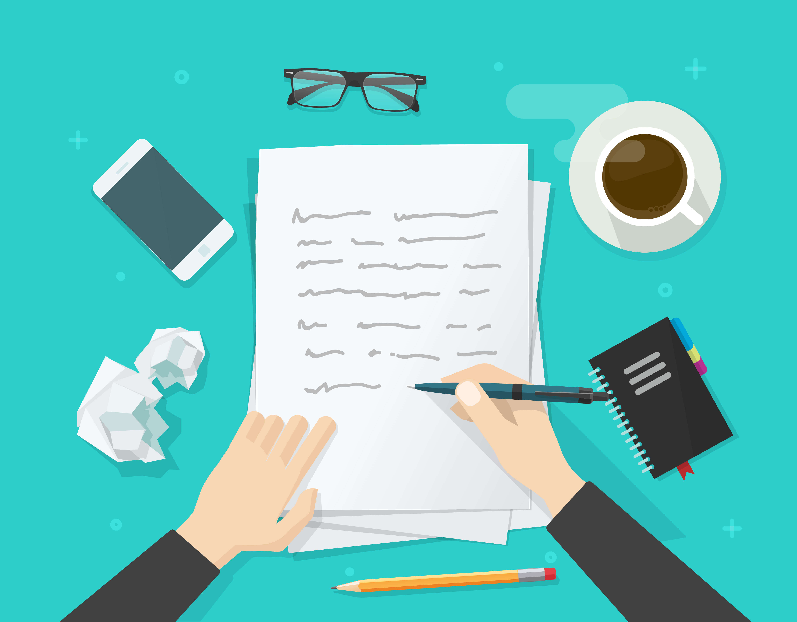
Step four: revisit your sentences
Sentences should fit your audience, convey what you want to say, and match the rest of the piece.
Strive to craft straightforward sentences that make sense and are punctuated properly.
Remember, the longest word is not always the best word! Just because you can use a technical or long word, doesn’t mean that’s the best choice for your audience.

Slide 9
Step five: reexamine your conclusion
Your reader will remember whatever you end with. Does your last sentence sound like an ending? Make sure that it’s the only one that does!
As you finish making your points and draw to a close, does your conclusion restate your main points and thesis in brief form?
Make sure that your conclusion does not sound repetitive. Ultimately, it should point to some larger significance and leave the reader with what you want them to remember!

Slide 10
Step six: triple check for errors
Spelling errors really jump out for readers. Make sure to run a spell-checker, but also keep an eye out for misused words. Unfortunately, though useful, spelling and grammar checkers do not catch every error! This is why reading aloud helps.
Check your style book (or handouts)—if your professor has assigned a handbook make sure that you refer to it for tips on format and usage.
Make sure there are no strange formatting errors or page breaks.

Slide 11
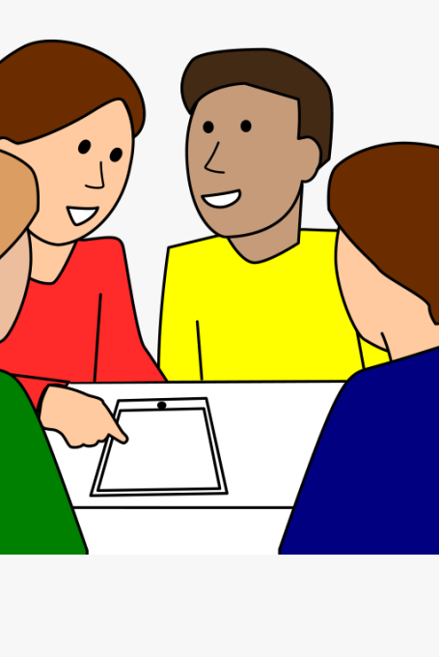
Step seven: enlist a second reader (or more)!
A second reader can point out things that you may have missed! They may point out lapses in logic or holes in your argument.
Use your ENA peers as test readers! If your professor gives you the opportunity for peer or group work, take it.
If you need more feedback, you can ask friends, family, and your fellow students. You can also book a visit at the Writing Center!
Writing is tough! No good writer does it completely on their own.

Slide 12
In conclusion
Writing is a long and winding road.
There are many stops on the journey to a finished paper.
Learning to revise and edit your work is key to improving as a writer!

Slide 13
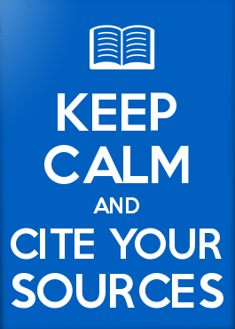
Works cited
Cohen, Sage. “Customize Your Self-Editing Approach.” Writer’s Digest, Sept. 2012, pp. 56–57, writersdigestshop.com/products/writers- digest-september-2012-pdf. Accessed 1 August 2021.
Fry, Don. “7 Steps to a Fullproof Revision.” Writer’s Digest, Sept. 2012, pp. 52–55, writersdigestshop.com/products/writers-digest- september-2012-pdf. Accessed 1 August 2021.
*This presentation was compiled and narrated by Dr. Lauren Navarro in collaboration with Dr. Suzanne Uzzilia.

